Slide 1
UNIT-III Content Beyond Syllabus
The Multiplier Control Unit:
By Using Delay Method & Sequence Counter Method

Slide 2
Design Methods for Hardwired Control
Sequence Counter Method:
The most popular method conveniently employed for design of controllers with moderate complexity
Delay Element Method
It depends on the use of clocked delay elements for generating the control signals
State Table Method
It employs the traditional algorithmic approach to sequential circuit design using classical state table method.

Slide 3
1. Sequence Counter Method
Steps:
Identify the distinct phases in the flowchart. Employ log p number of flip flops to handle p number distinct phases.
Identify the maximum number of distinct steps, k, in each of the phases. Employ a mod k counter to generate control signals for each of the k steps.
Design a combinational logic circuit to generate the sequence of control signals to control the micro operations of each phase; the signals for counter reset and phase control are also generated by the combinational logic.

Slide 4
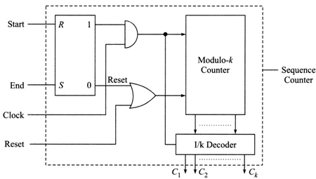
1. Sequence Counter Method (cont..)

Slide 5
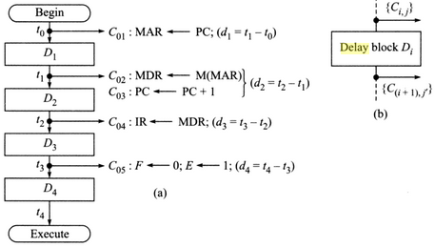
2. Delay Element Method
Control unit based on delay element method for the fetch cycle

Slide 6
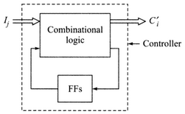
3. State Table Method
The states S_{i} (i=1,2…) of the controller generate the control signals to control the micro operations in the data path.
A controller in state ,say S_{i}, on receiving the primary input signals I_{j} switches over to the state S_{i’} while generating the output signals {C’_{i}}.
This set of output signals {C’_{i}} execute the micro operations.

Slide 7
3. State Table Method (cont..)
It includes following steps:
State assignment: It specifies the particular state of the controller at the specific time stamp.
State Minimization: A set of states (S_{a}, S_{b}, …S_{c} ) can be merged into a single state S’ if S_{i} and S_{j} (i≠j, i,j=a,b,c..) is pairwise compatible i.e. the output sequence {O_{i}} and {O_{j}} (that result from any input sequence I to the control unit in state S_{i} and S_{j} as initial states) are identical whenever they are specified.
State Encoding: State variables are defined and states are encoded in terms of state variables.

Slide 8
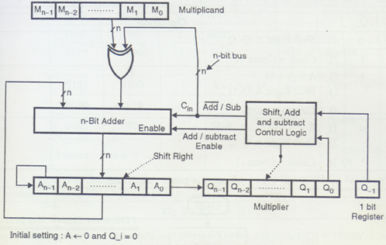
Multiplier Unit (Hardware Implementation of Booth’s Algorithm)

Slide 9
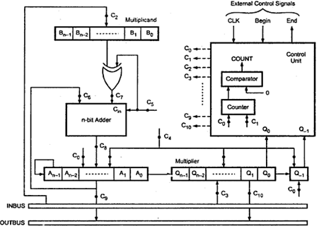
Multiplier Control Unit with Control Signals

Slide 10
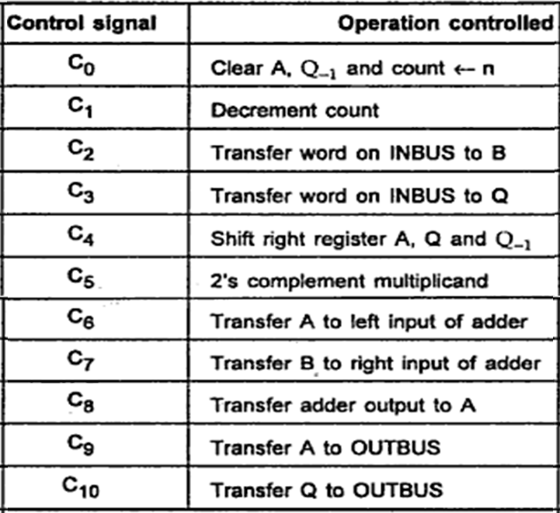
Control Signals for the 2’s Complement Multiplier

Slide 11





Slide 12


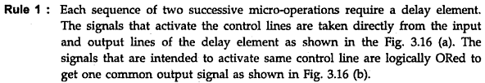

Slide 13
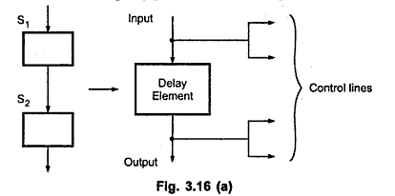
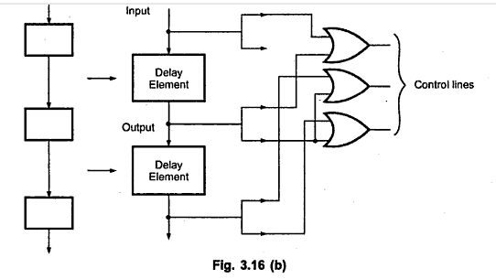

Slide 14
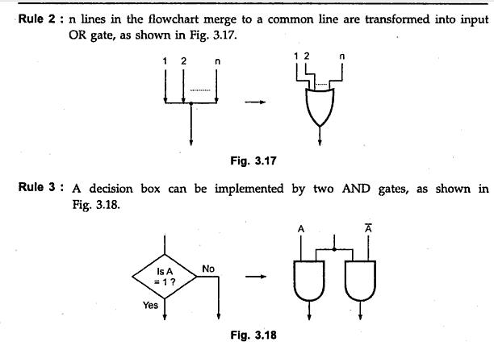

Slide 15

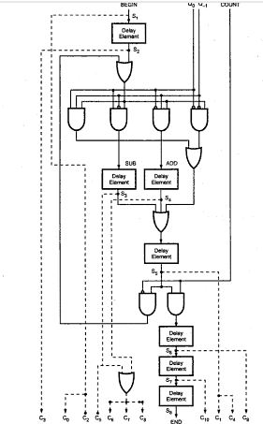
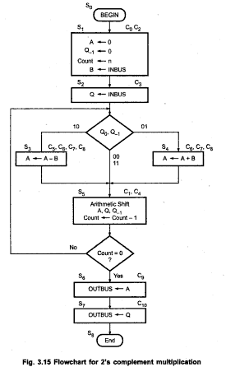

Slide 16
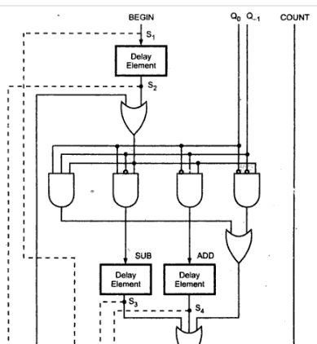

Slide 17
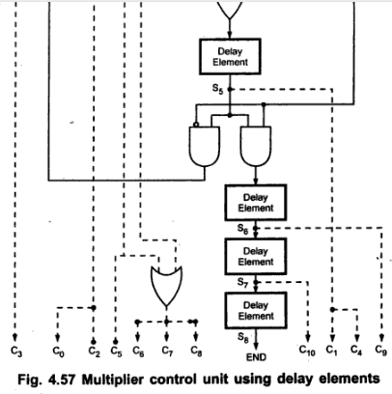

Slide 18



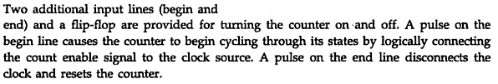

Slide 19
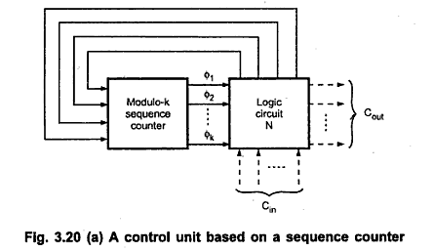

Slide 20
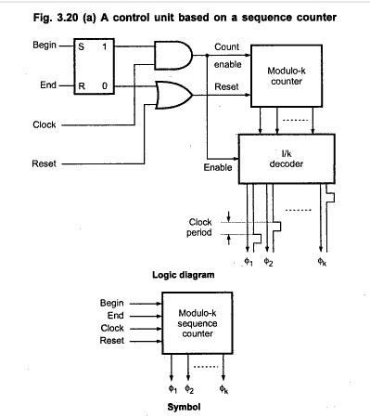

Slide 21

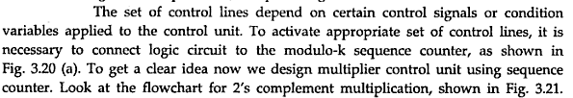

Slide 22
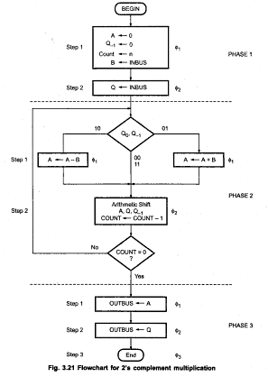

Slide 23
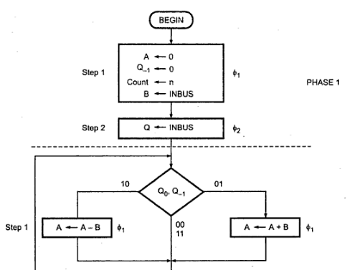

Slide 24
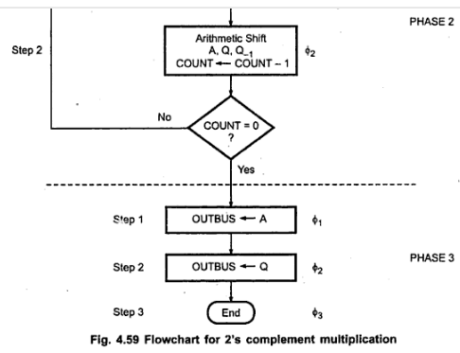

Slide 25
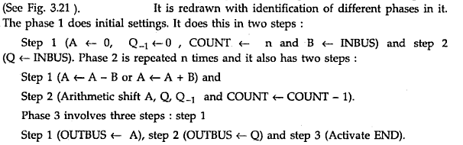

Slide 26
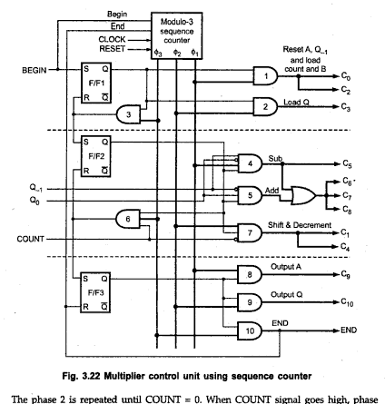

Slide 27
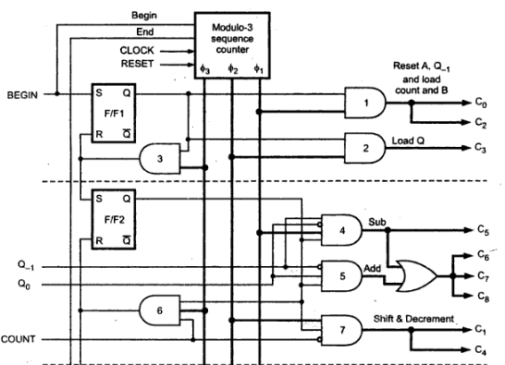

Slide 28
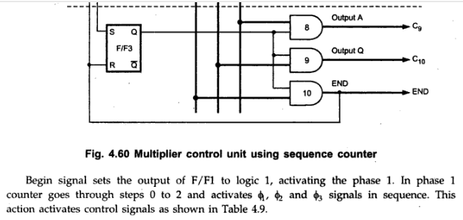

Slide 29
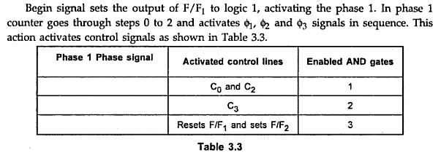
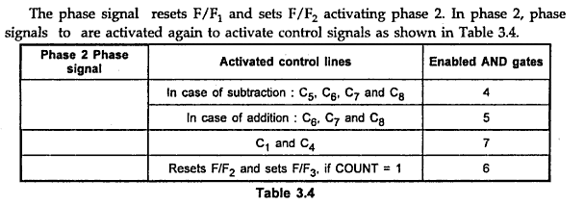

Slide 30
